Slide 1
Analog Interfacing

Slide 2
Why It’s Needed
Embedded systems often need to measure values of physical parameters
These parameters are usually continuous (analog) and not in a digital form which computers (which operate on discrete data values) can process
Temperature
Thermometer (do you have a fever?)
Thermostat for building, fridge, freezer
Car engine controller
Chemical reaction monitor
Safety (e.g. microprocessor processor thermal management)
Light (or infrared or ultraviolet) intensity
Digital camera
IR remote control receiver
Tanning bed
UV monitor
Rotary position
Wind gauge
Knobs
Pressure
Blood pressure monitor
Altimeter
Car engine controller
Scuba dive computer
Tsunami detector
Acceleration
Air bag controller
Vehicle stability
Video game remote
Mechanical strain
Other
Touch screen controller
EKG, EEG
Breathalyzer

Slide 3
Converting Between Analog and Digital Values

Slide 4
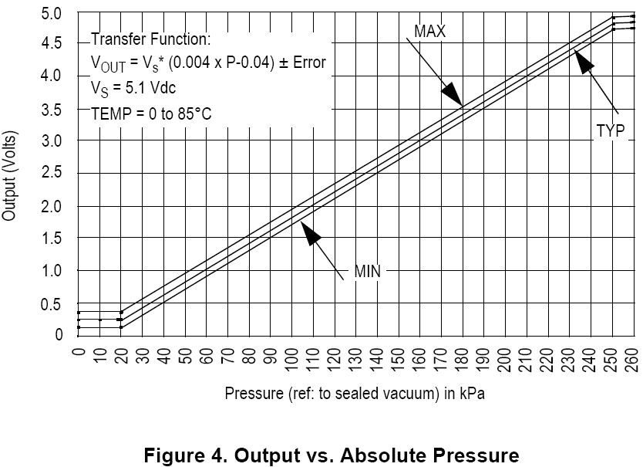
The Big Picture – A Depth Gauge
V_ref
// Your software
ADC_Code = ADC0->R[0];
V_sensor = ADC_code*V_ref/1023;
Pressure_kPa = 250 * (V_sensor/V_supply+0.04);
Depth_ft = 33 * (Pressure_kPa –
Atmos_Press_kPa)/101.3;
Pressure Sensor
Analog to Digital Converter
Water Pressure
Voltages
ADC Output Codes
V_sensor
ADC_Code
V_ref
111..111
111..110
111..101
111..100
V_sensor
ADC_Code
Ground
000..001
000..000
Sensor detects water pressure and generates a proportional output voltage V_sensor
ADC generates a proportional digital integer (code) based on V_sensor and V_ref
Code can convert that integer to a something more useful
first a float representing the voltage,
then another float representing pressure,
finally another float representing depth
Notes:
Let’s take a look at how an electronic depth gauge on a scuba diver or submarine works using an analog to digital converter.

Slide 5
Getting From Analog to Digital
A Comparator tells us “Is V_{in} > V_{ref}?”
Compares an analog input voltage with an analog reference voltage and determines which is larger, returning a 1-bit number
E.g. Indicate if depth > 100 ft
Set V_{ref} to voltage pressure sensor returns with 100 ft depth.
An Analog to Digital converter [AD or ADC] tells us how large V_{in} is as a fraction of V_{ref}.
Reads an analog input signal (usually a voltage) and produces a corresponding multi-bit number at the output.
E.g. calculate the depth
Comparator
Vin
0
Vref
A/D Converter
Vref
0
1
0
1
Vin
Clock
Notes:
There are two common devices used to convert from analog to digital. The comparator gives a simple Higher/Lower answer, while the ADC gives a proportional digital value.

Slide 6
Digital to Analog Conversion
May need to generate an analog voltage or current as an output signal
E.g. audio signal, video signal brightness.
DAC: “Generate the analog voltage which is this fraction of V_{ref}”
Digital to Analog Converter equation
n = input code
N = number of bits of resolution of converter
V_{ref} = reference voltage
V_{out} = output voltage. Either
V_{out} = V_{ref} * n/(2^{N}) or
V_{out} = V_{ref} * (n+1)/(2^{N})
The offset +1 term depends on the internal tap configuration of the DAC – check the datasheet to be sure
D/A Converter
0
1
0
1
Vout
Vref

Slide 7
Waveform Sampling and Quantization
Digital value
time
A waveform is sampled at a constant rate – every Δt
Each such sample represents the instantaneous amplitude at the instant of sampling
“At 37 ms, the input is 1.91341914513451451234311… V”
Sampling converts a continuous time signal to a discrete time signal
The sample can now be quantized (converted) into a digital value
Quantization represents a continuous (analog) value with the closest discrete (digital) value
“The sampled input voltage of 1.91341914513451451234311… V is best represented by the code 0x018, since it is in the range of 1.901 to 1.9980 V which corresponds to code 0x018.”

Slide 8
Forward Transfer Function Equations
What code n will the ADC use to represent voltage V_{in}?
General Equation
n = converted code
V_{in} = sampled input voltage
V_{+ref} = upper voltage reference
V_{-ref} = lower voltage reference
N = number of bits of resolution in ADC
Simplification with V_{-ref} = 0 V
(
V
)
2
N
n
=
⎢
in
+
1
/
2
⎥
⎢
V
⎥
⎣
+
ref
⎦
(
)
3
.
30
v
2
10
−
N
n
=
⎢
+
1
/
2
⎥
=
676
V
V
−
2
⎣
5
v
⎦
n
=
⎢
in
ref
+
1
/
2
⎥
⎢
V
−
V
⎥
⎣
+
ref
−
ref
⎦
X = I
floor function: nearest integer I such that I <= X
floor(x+0.5) rounds x to the nearest integer
⎣
⎦

Slide 9
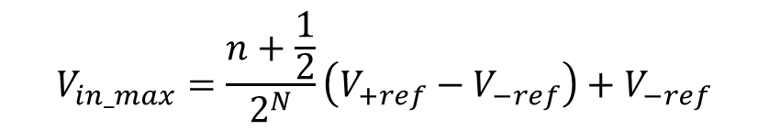
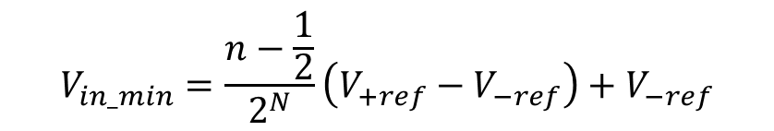
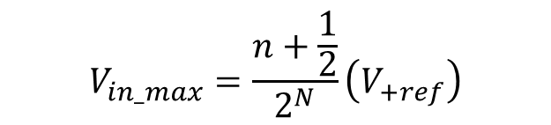
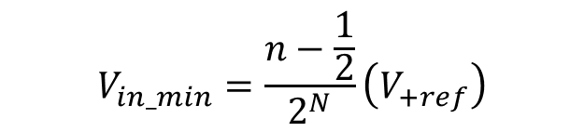
Inverse Transfer Function
What range of voltages V_{in_min} to V_{in_max} does code n represent?
General Equation
n = converted code
V_{in_min} = minimum input voltage for code n
V_{in_max} = maximum input voltage for code n
V_{+ref} = upper voltage reference
V_{-ref} = lower voltage reference
N = number of bits of resolution in ADC
Simplification with V_{-ref} = 0 V
$$V_{in_min}=\frac{n−\frac{1}{2}}{2^{N}}\left(V_{+ref}\right)$$
$$V_{in_max}=\frac{n+\frac{1}{2}}{2^{N}}\left(V_{+ref}\right)$$
$$V_{in_min}=\frac{n−\frac{1}{2}}{2^{N}}\left(V_{+ref}−V_{−ref}\right)+V_{−ref}$$
$$V_{in_max}=\frac{n+\frac{1}{2}}{2^{N}}\left(V_{+ref}−V_{−ref}\right)+V_{−ref}$$

Slide 10
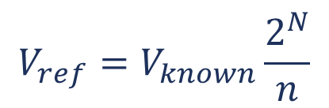

What if the Reference Voltage is not known?
Example - running off an unregulated battery (to save power)
Measure a known voltage and an unknown voltage
Many MCUs include an internal fixed voltage source which ADC can measure for this purpose
Can also solve for Vref
$$V_{unknown}=V_{known}\frac{n_{unknown}}{n_{known}}$$
$$V_{ref}=V_{known}\frac{2^{N}}{n}$$
“My ADC tells me that channel 27 returns a code of 0x6543, so I can calculate that V_{REFSH} = 1.0V * 2¹⁶/0x6543 = …

Slide 11
Analog to Digital conversion concepts

Slide 12
A/D – Flash Conversion
A multi-level voltage divider is used to set voltage levels over the complete range of conversion.
A comparator is used at each level to determine whether the voltage is lower or higher than the level.
The series of comparator outputs are encoded to a binary number in digital logic (a priority encoder)
Components used
2^{N} resistors
2^{N}-1 comparators
Note
This particular resistor divider generates voltages which are not offset by ½ bit, so maximum error is 1 bit
We could change this offset voltage by using resistors of values R, 2R, 2R ... 2R, 3R (starting at bottom)
1V
Comparators
7/8 V
R
+
1
R
6/8 V
-
R
+
1
5/8 V
-
R
+
1
4/8 V
-
R
+
Encoder
3
0
3/8 V
-
R
+
0
2/8 V
-
R
+
0
1/8 V
-
R
+
0
-
V
in

Slide 13
ADC - Successive Approximation Conversion
Successively approximate input voltage by using a binary search and a DAC
SA Register holds current approximation of result
Set all DAC input bits to 0
Start with DAC’s most significant bit
Repeat
Set next input bit for DAC to 1
Wait for DAC and comparator to stabilize
If the DAC output (test voltage) is smaller than the input then set the current bit to 1, else clear the current bit to 0
111111
Test voltage (DAC output)
Analog Input
100110
Voltage
100100
100000
know xxxxxx, try 100000
know 10011x, try 100111
know 1001xx, try 100110
know 100xxx, try 100100
know 10xxxx, try 101000
know 1xxxxx, try 110000
know 100110. Done.
T
T
T
T
T
T
000000
1
2
3
4
5
6
Start of
Conversion
Time

Slide 14
A/D - Successive Approximation
Converter Schematic
Notes:
The hardware for the successive approximation ADC uses a comparator to compare the input voltage against a test voltage generated by the D/A converter, which is driven by the successive approximation register according to the sequence on the previous slide.

Slide 15
ADC Performance Metrics
Linearity measures how well the transition voltages lie on a straight line.
Differential linearity measure the equality of the step size.
Conversion time: between start of conversion and generation of result
Conversion rate = inverse of conversion time

Slide 16
Sampling Problems
Nyquist criterion
F_{sample} >= 2 * F_{max frequency component}
Frequency components above ½ F_{sample} are aliased, distort measured signal
Nyquist and the real world
This theorem assumes we have a perfect filter with “brick wall” roll-off
Real world filters have more gentle roll-off
Inexpensive filters are even worse (e.g. first order filter is 20 dB/decade, aka 6 dB/octave)
So we have to choose a sampling frequency high enough that our filter attenuates aliasing components adequately

Slide 17
Inputs
Differential
Use two channels, and compute difference between them
Very good noise immunity
Some sensors offer differential outputs (e.g. Wheatstone Bridge)
Multiplexing
Typically share a single ADC among multiple inputs
Need to select an input, allow time to settle before sampling
Signal Conditioning
Amplify and filter input signal
Protect against out-of-range inputs with clamping diodes

Slide 18
Sample and Hold Devices
Some A/D converters require the input analog signal to be held constant during conversion (e.g. successive approximation devices)
In other cases, peak capture or sampling at a specific point in time requires a sampling device.
A “sample and hold” circuit performs this operation
Many A/D converters include a sample and hold circuit

Slide 19
KL25 Analog Interfacing Peripherals

Slide 20
Sources of Information
KL25 Subfamily Reference Manual (Rev. 1, June 2012)
Describes architecture of peripherals and their control registers
Digital to Analog Converter
Chapter 30 of KL25 Subfamily Reference Manual
Analog Comparator
Chapter 29 of KL25 Subfamily Reference Manual
Analog to Digital Converter
Chapter 28 of KL25 Subfamily Reference Manual
KL25 Sub-family Data Sheet (Rev. 3, 9/19/2012)
Describes circuit-specific performance parameters: operating voltages, min/max speeds, cycle times, delays, power and energy use

Slide 21
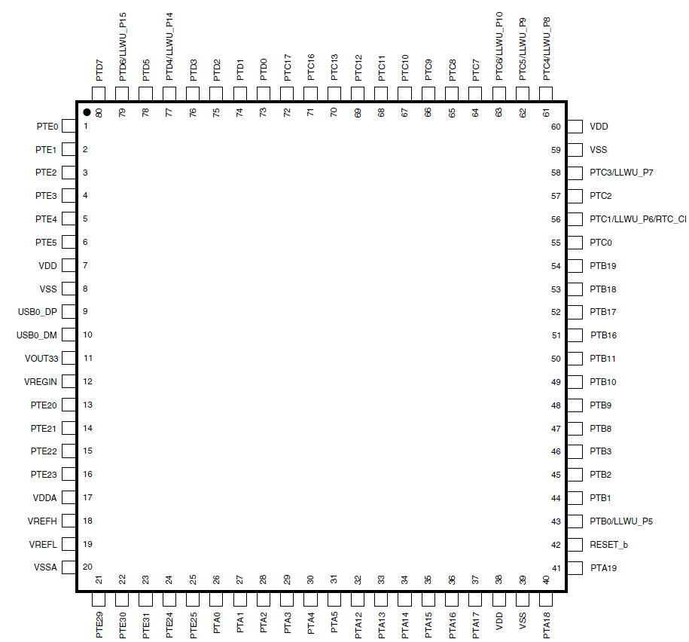
KL25Z Analog Interface Pins
80-pin QFP
Inputs
1 16-bit ADC with 14 input channels
1 comparator with 6 external inputs, one 6-bit DAC
Output
1 12-bit DAC
Notes:
The MCU has multiple analog inputs and one analog output

Slide 22
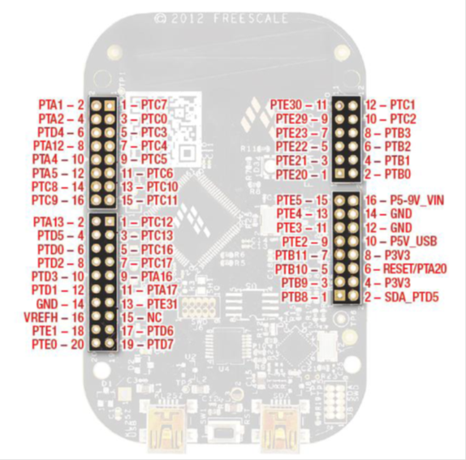
Freedom KL25Z Analog I/O
Inputs
14 external ADC channels
6 external comparator channels
Output
1 12-bit DAC

Slide 23
Using a Pin for Analog Input or Output
Configuration
Direction
MUX
Data
Output (different ways to access it)
Input
Notes:
In order to use a pin for as an analog input or output we need to configure the pin control multiplexer to connect to the correct peripheral rather than the GPIO port circuitry.

Slide 24
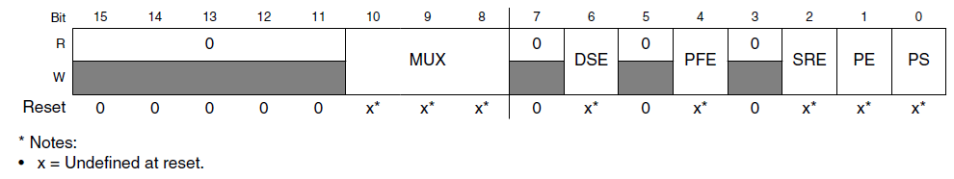
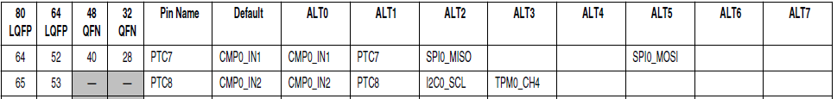
Pin Control Register to Select MUX Channel
MUX (bits 10-8) | Configuration
000 | Digital circuits disabled, analog enabled
001 | Alternative 1 – GPIO
010 | Alternative 2
011 | Alternative 3
100 | Alternative 4
101 | Alternative 5
110 | Alternative 6
111 | Alternative 7
MUX field of PCR defines connections
PORTC->PCR[7] &= ~PORT_PCR_MUX_MASK;
PORTC->PCR[7] |= PORT_PCR_MUX(0);
Notes:
Here we see the pin control register for pins PTC7 and PTC8. We need to set the mux bits to 000 to select the analog functionality (Comparator 0 inputs 1 and 2).

Slide 25
Digital to Analog Converter

Slide 26
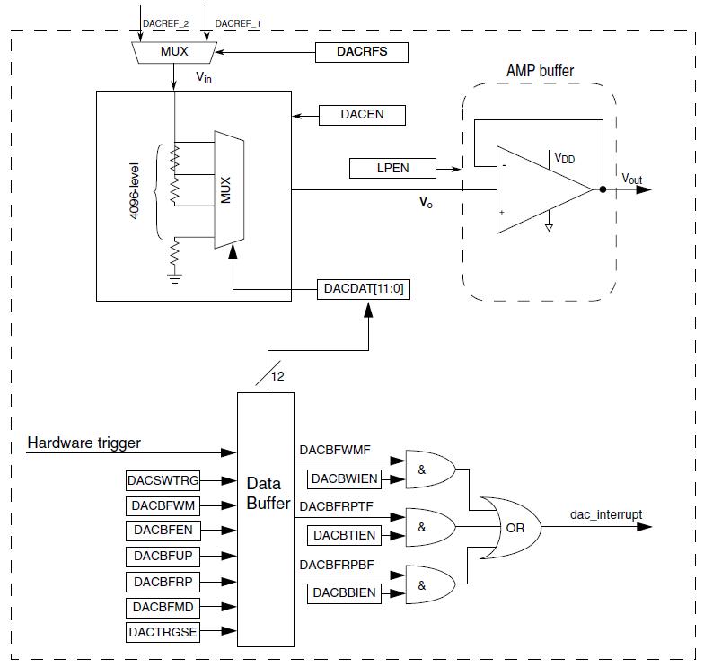
DAC Overview
Load DACDAT with 12-bit data N
MUX selects a node from resistor divider network to create V_{o} = (N+1)*V_{in}/2¹²
V_{o} is buffered by output amplifier to create V_{out}
V_{o} =V_{out} but V_{o} is high impedance - can’t drive much of a load, so need to buffer it
Notes:
The Digital to Analog Converter (DAC) generates an output voltage by scaling its input reference voltage by a fraction between 0 and 1, equal to (N+1)/2¹².

Slide 27
DAC Operating Modes
Normal
DAT0 is converted to voltage immediately
Buffered
Data to output is stored in 16-word buffer
Next data item is sent to DAC when a selectable trigger event occurs
Software Trigger - write to DACSWTRG field in DACx_C0
Hardware Trigger - from PIT timer peripheral
Normal Mode
Circular buffer
One-time Scan Mode
Pointer advances until reaching upper limit of buffer, then stops
Status flags in DACx_SR

Slide 28
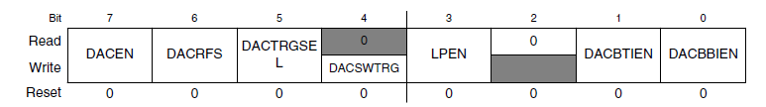
DAC Control Register 0: DACx_C0
DACEN - DAC Enabled when 1
DACRFS - DAC reference voltage select
0: DACREF_1. Connected to VREFH
1: DACREF_2. Connected to VDDA
LPEN - low-power mode
0: High-speed mode. Fast (15 us settling time) but uses more power (up to 900 uA supply current)
1: Low-power mode. Slow (100 us settling time) but more power-efficient (up to 250 uA supply current)
Additional control registers used for buffered mode

Slide 29
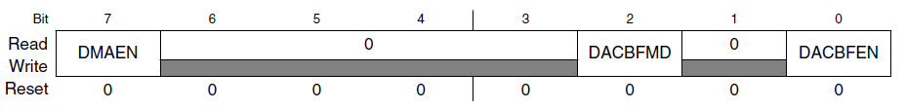
DAC Control Register 1: DACx_C1
DACBFEN
0: Disable buffer mode
1: Enable buffer mode
DACBFMD - Buffer mode select
0: Normal mode (circular buffer)
1: One-time scan mode

Slide 30
DAC Data Registers
These registers are only eight bits long
DATA[11:0] stored in two registers
DATA0: Low byte [7:0] in DACx_DATnL
DATA1: High nibble [11:0] in DACx_DATnH

Slide 31
Example: Waveform Generator
Supply clock to DAC0 module
Bit 31 of SIM SCGC6
Set Pin Mux to Analog (0)
Enable DAC
Configure DAC
Reference voltage
Low power mode?
Normal mode (not buffered)
Write to DAC data register

Slide 32
Analog Comparator

Slide 33
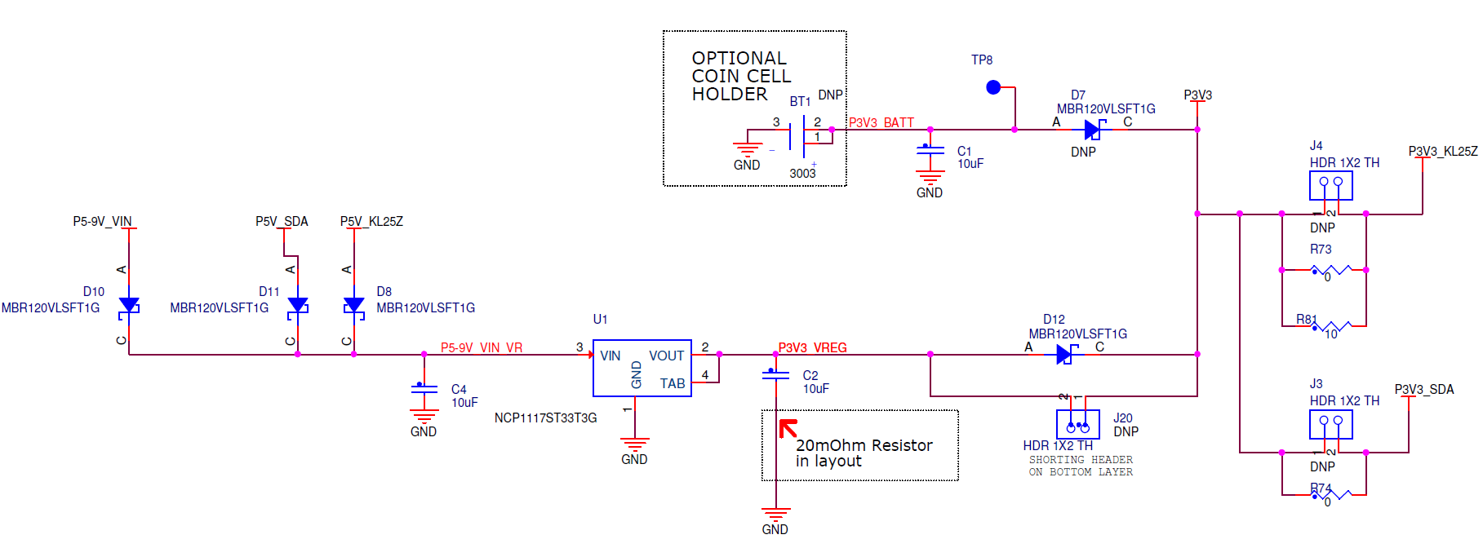
Example: Power Failure Detection
Need warning of when power has failed
Very limited amount of time before capacitor C2 discharges
Save critical information
Turn off output devices
Put system into safe mode
Can use a comparator to compare V_{in} against a fixed reference voltage V_{Ref}

Slide 34
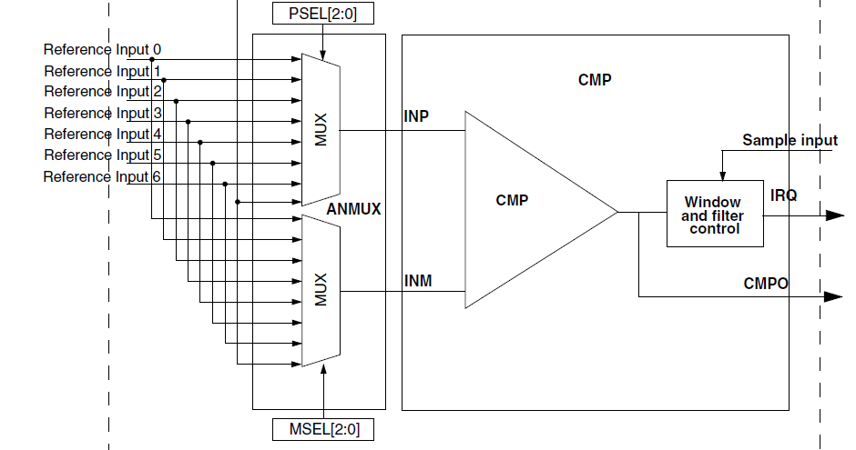
Comparator Overview
Comparator compares INP and INM
CMPO Output indicates if INP>INM (1) or INP<INM (0)
Can generate an interrupt request (+, -, or +- edges)
ANMUX selection of one of multiple reference inputs, using PSEL and MSEL fields

Slide 35

CMP Control Register 1 CMPx_CR1
EN: Module enable (1)
OPE: Output Pin Enable
1: connects comparator output signal CMPO to output pin
PMODE: Power Mode Select
0: Low speed
1: High speed

Slide 36
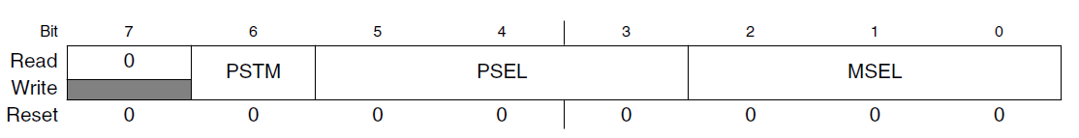
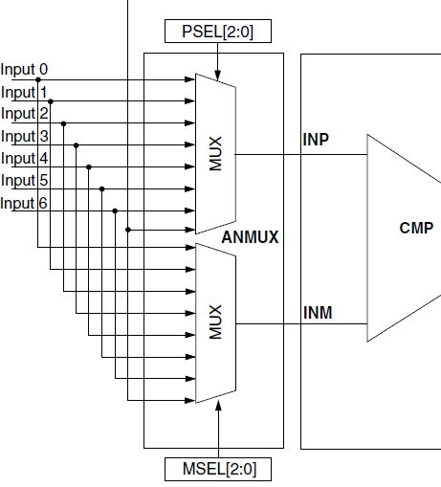
MUX Control Register CMPx_MUXCR
PSTM: Enable Pass Through Mode
PSEL: Plus Input Mux Control
Selects which input (IN0-7) goes to the comparator’s + input
MSEL: Minus Input Mux Control
Selects which input (IN0-7) goes to the comparator’s - input

Slide 37
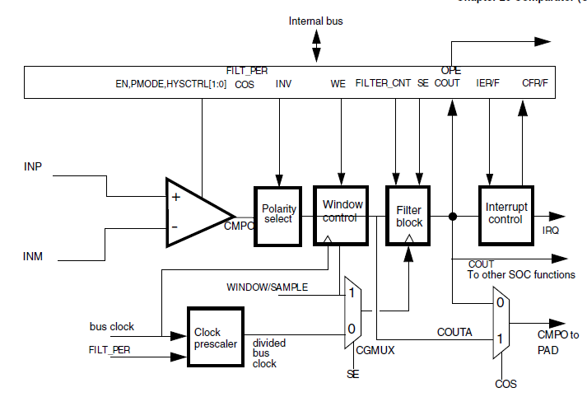
Comparator Output Processing
Notes:
The output of the comparator is processed in several stages before possibly generating an interrupt or an output signal. We examine these on the next slide.

Slide 38
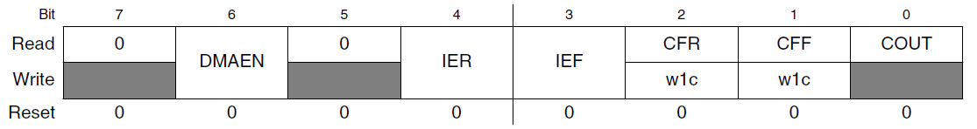
Comparator Interrupt
CMPx_SCR: Status and control register
COUT: output of comparator
CFR: Comparator flag rising. Rising edge detected on comparator output COUT. Clear flag by writing with a 1.
CFF: Comparator flag falling. Falling edge detected on comparator output COUT. Clear flag by writing with a 1.
IER: 1 enables interrupt when CFR is set.
IEF: 1 enables interrupt when CFF is set.
Can generate interrupt on matching edge
CMSIS-defined ISR name for Comparator Interrupt is CMP0_IRQHandler
Notes:
We can configure the comparator to generate an interrupt when the comparator output rises or falls, or both.

Slide 39
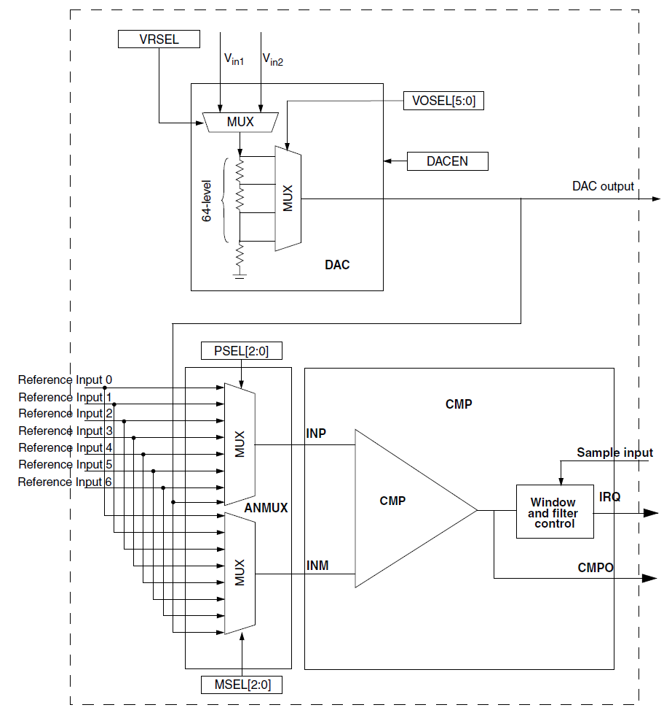
Programmable Threshold for Comparator
Comparator has 6-bit DAC
Can use DAC to set threshold voltage for comparator
Supports 64 different threshold voltages

Slide 40

DAC Control Register CMPx_DACCR
DACEN: Enable CMP DAC (1)
VRSEL: DAC reference voltage select
0: Connected to VREFH
1: Connected to VDD
VOSEL: Output voltage select
V_{DACO} = (VOSEL+1)*(V_{in}/64)
VOSEL = 64*(V_{DACO} /V_{in}) - 1

Slide 41
Analog to Digital Converter

Slide 42
ADC Overview
Uses successive approximation for conversion
Supports multiple resolutions: 16, 13, 12, 11, 10, 9, and 8 bits
Supports single-ended and differential conversions
Signed or unsigned results available
Up to 24 analog inputs supported (single-ended), 4 pairs of differential inputs
Automatic compare and interrupt for level and range comparisons
Hardware data averaging
Temperature sensor

Slide 43
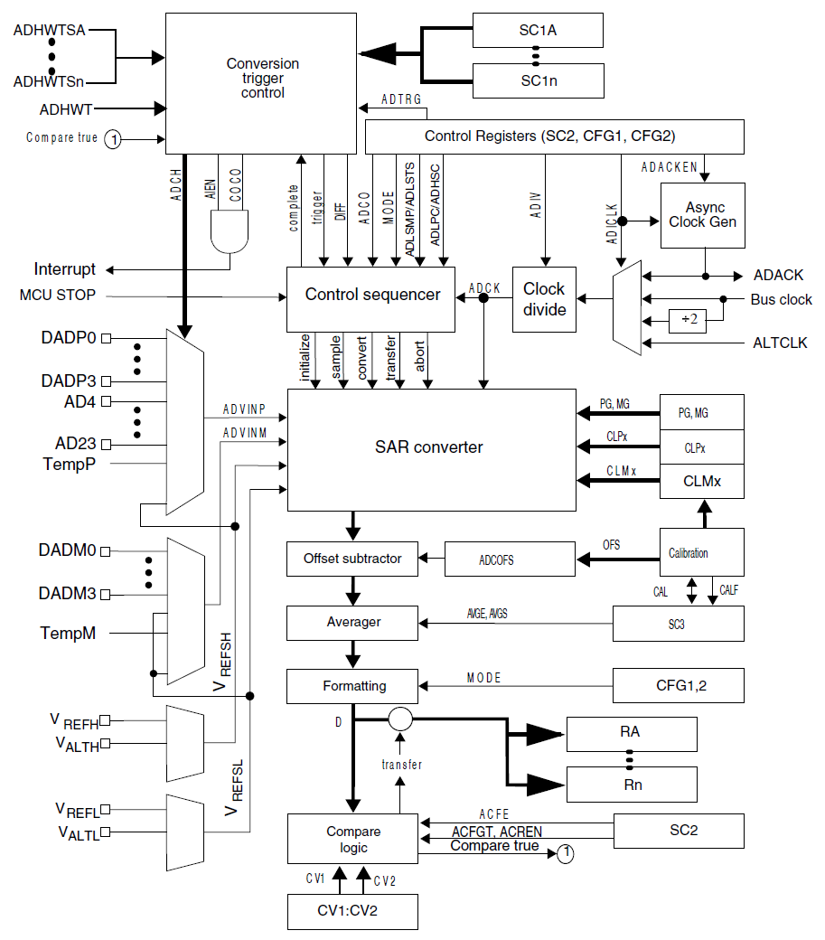
ADC System Overview
Notes:
The ADC is many features and may look overwhelming initially. On the next page we will start looking at its major parts.

Slide 44
ADC System Fundamentals
Conversion Clock
Analog Inputs
A/D Converter
Result
Registers
Analog Inputs
Notes:
The heart of the ADC is the SAR converter in the center. This is driven by a conversion clock with a configurable speed to let us trade off speed, accuracy and power. The ADC will convert an analog input (or the difference between two, in differential mode) into a digital value which is placed in a result register.

Slide 45
Using the ADC
ADC initialization
Configure clock
Select voltage reference
Select trigger source
Select input channel
Select other parameters
Trigger conversion
Read results
Notes:
Here are the basic steps to using the ADC.

Slide 46
Clock Configuration
Select clock source with ADICLK
Bus Clock (default)
ADACK: Local clock, allows ADC operation while rest of CPU is in stop mode
ALTCLK: alternate clock (MCU-specific)
Divide down selected clock by factor of ADIV, creating ADCK
Resulting ADCK must be within valid range to ensure accuracy (See KL25 Subfamily datasheet)
1 to 18 MHz (<= 13-bit mode)
2 to 12 MHz (16-bit mode)

Slide 47
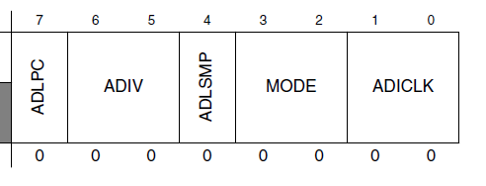
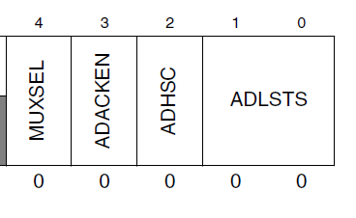
Clock Configuration Registers
ADCx_CFG1
ADIV: divide clock by 2^{ADIV}
00: 1
01: 2
10: 4
11: 8
ADICLK: Input clock select
00: Bus clock
01: Bus clock/2
10: ALTCLK
11: ADACK
ADCx_CFG2
ADACKEN: Enable asynchronous clock

Slide 48
Voltage Reference Selection
Two voltage reference pairs available
V_{REFH}, V_{REFL}
V_{ALTH}, V_{ALTL}
Select with SC2 register’s REFSEL bits
00: V_{REFH}, V_{REFL}
01: V_{ALTH}, V_{ALTL}
10, 11: Reserved
KL25Z
V_{ALTH} connected to V_{DDA}
Notes:
We need to select which reference voltages to use. The lower reference indicates the voltage resulting in a 0000…000 conversion, while the upper reference is for a 1111….1111 conversion result.

Slide 49
Conversion Trigger Selection
ADTRG in SC2
0: software trigger
1: hardware trigger
Software trigger:
Write to SC1A
Ping-pong buffering
SC1A vs. SC1n
Hardware trigger:
Rising edge of ADHWT signal
ADHWT sources: TPM, LPTMR, PIT, RTC, EXTRG_IN, HSCMP0
Notes:
We can select how to trigger the ADC. Both software and hardware triggering are available.

Slide 50
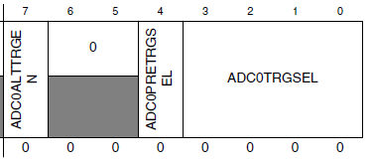
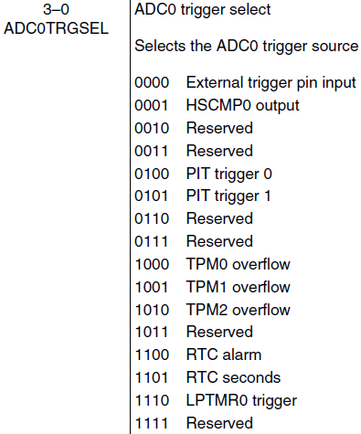
Hardware Trigger Sources
System Integration Module
SIM_SOPT7 register
See section 12.2.6 of Reference Manual
ADC0ALTTRGEN: Alternate trigger enable
ADC0PRETRGSEL: ADC pre-trigger select

Slide 51
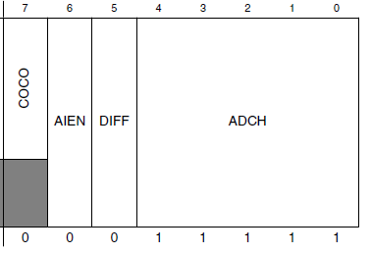
Input Channel Selection
Two modes, selected by SC1n[DIFF] bit
0: Single-ended
1: Differential
Input channel selected by value of ADCH
Extras
Reference voltages
Temperature
Band Gap
Notes:
We can select whether the conversion is of a single channel or the difference between two channels. We also can measure other analog voltages, described on the next page.

Slide 52
ADC Inputs on Freedom Board
ADC Channel (Single-Ended) | MCU Signal (with ALT0 multiplexer setting) | Freedom KL25Z Connector and Pin Number
0 | PTE20 | J10 1
3 | PTE22 | J10 5
4 | PTE21 (a), PTB29 (b) | J10 3 (a), J10 9 (b)
5 | PTD1 (b) | J2 12 (b)
6 | PTD5 (b) | J2 4 (b)
7 | PTE23 (a), PTD6 (b) | J10 7 (a), J2 17(b)
8 | PTB0 | J10 2
9 | PTB1 | J10 4
11 | PTC2 | J10 10
12 | PTB2 | J10 6
13 | PTB3 | J10 8
14 | PTC0 | J1 3
15 | PTC1 | J10 12
23 | PTE30 | J10 11

Slide 53
Special Input Channels
26: Temperature Sensor
T = 25°C - ((V_{Temp} - V_{Temp25})/m)
m = 1.715 mV/°C
V_{TEMP25} = 719 mV
V_{Temp} is derived from ADC conversion result
27: Band Gap
Nominally 1.0 V, +/- 3%
Used to allow calculation of reference voltage if it is not calibrated/regulated
Enable BG buffer by setting BGBE bit in Power Management Control REGSC
“My ADC tells me that channel 27 returns a code of 36000, and channel 0 returns a code of 25145. So V₀ = 36000/25145 * 1.0 V = 1.432 V
29, 30: Reference voltages
29: V_{REFSH}
30: V_{REFSL}

Slide 54
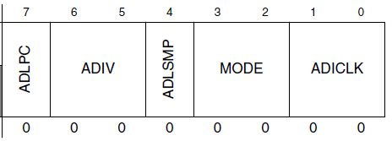
Conversion Options Selection
Low power
Set ADLPC (in ADCx_CFG1) to 1
Slower max clock speed
Long sample time select
Set ADLSMP (in ADCx_CFG1) to 1
Can select longer sample time with ADLSTS bits (in ADCx_CFG2) to add 20, 16, 10 or 6 ADCK cycles)
Conversion mode
MODE (in ADCx_CFG1)
Sets result precision (8 through 16 bits)
Continuous vs. single conversion
Set ADCO (in ADCx_SC3) to 1 for continuous conversions

Slide 55
Conversion Completion
Signaled by COCO bit in SC1n
Can generate conversion complete interrupt if AIEN in SC1 is set
CMSIS-defined ISR name for ADC Interrupt is ADC0_IRQHandler

Slide 56
Result Registers
Optional output processing before storage in result registers
Offset subtraction from calibration
Averaging: 1, 4, 8, 16 or 32 samples
Formatting: Right justification, sign- or zero-extension to 16 bits
Output comparison
Two result registers RA and Rn
Conversion result goes into register corresponding to SC1 register used to start conversion (SC1A, SC1n)

Slide 57
Output Averaging
Accumulate and average multiple samples before writing the averaged result to the result register
Result rate = sample rate / averaging factor
SC3 register
AVGE: average enable
AVGS: average sample count
AVGE | AVGS | Number of samples averaged
0 | xx | 1
1 | 00 | 4
1 | 01 | 8
1 | 10 | 16
1 | 11 | 32

Slide 58
Automatic Compare
Can ignore ADC result based on comparison with CV1 and CV2
Above or equal to threshold
Below threshold
Outside range
Inside range
Ignored result…
Not saved to RA/Rn
CoCo not set

Slide 59
Conversion Time Requirements
Precision (bits) | Mode | Base Conversion Time BCT
8 | single-ended | 17 ADCK cycles
9 | differential | 27
10 | single-ended | 20
11 | differential | 30
12 | single-ended | 20
13 | differential | 30
16 | single-ended | 25
16 | differential | 34
Conversion time depends on multiple factors
Precision in bits
Single-ended vs. differential
Adders: LST, HSC, SFC
Averaging

Slide 60
Using ADC Values
The ADC gives an integer representing the input voltage relative to the reference voltages
Several conversions may be needed
For many applications you will need to compute the approximate input voltage
V_{in} = …
For some sensor-based applications you will need to compute the physical parameter value based on that voltage (e.g. pressure) – this depends on the sensor’s transfer function
You will likely need to do additional computations based on this physical parameter (e.g. compute depth based on pressure)
Data type
It’s likely that doing these conversions with integer math will lead to excessive loss of precision, so use floating point math
AFTER you have the application working, you can think about accelerating the program using fixed-point math (scaled integers).
Sometimes you will want to output ASCII characters (to the LCD, for example). You will need to convert the floating point number to ASCII using sprintf, ftoa, or another method.

